Slide 1

It is very important that you stay as still as possible
during the experiment in the MRI machine.
.
If you need to move a bit or stretch, please do so between runs, when the scanner is not running.

Slide 2
Welcome The following presentation will guide you through how to respond to our rating scales.

Slide 3
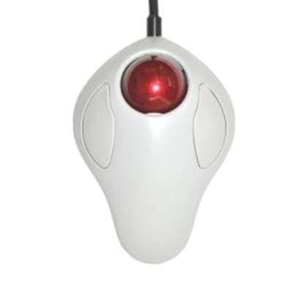
You have been given a trackball or an alternative response device in your dominant hand.

Slide 4

Spinning the trackball to the right will move rating indicators to the right-side of the scale, typically indicating an increase in your rating.

Slide 5
Spinning the trackball to the left will move rating indicators to the left-side of the scale, typically indicating a decrease in your rating.

Slide 6
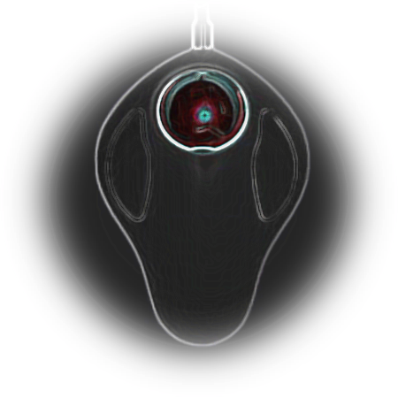
You may submit your response using the left button. Do not use the right button to submit a response.

Slide 7


What to Expect
Using the trackball in the scanner, you will be able to resize the triangle to indicate your rating.

Slide 8
What to Expect
How intense was this overall?
Not at all: “I feel that this experience was not at all intense.”
A little bit: “I feel that this experience was slightly intense.”
Moderately: “I feel as though this experience was moderately intense.”
Strongly: “I feel that this experience was intense.”
Very strongly: “I feel that this experience was very intense.”
Most: “This experience was so intense that it is the worst I have ever experienced”

Slide 9

This is an example of a scale rating comfort.
Once in the scanner you can use the trackball to resize the triangle and click to submit your rating.

Slide 10
How comfortable do you feel right now?
The thoughts I experienced during the last scan were negative. [yes/no]
Please rate how much you want to avoid this experience in the future?

Slide 11
Could you explain back to me how you understand the rating scale?

Slide 12
Intensity is how loud the song is.
Unpleasantness is how much you dislike the song.
Please keep this distinction in mind when you're asked rate the stimuli.
Notes:
One last thing! You will be asked about both intensity and unpleasantness Let’s go over the difference between intensity and unpleasantness so that you're equipped to properly understand the prompt.
After some runs we will also ask you to rate the INTENSITY and the PLEASANTNESS OR UNPLEASANTNESS of the sensations you experienced in the scanner. We will always ask you about the STRONGEST sensation of each kind you experienced, as you might experience different levels of each stimulus and the strongest one is usually what we remember best.
These two rating scales (intensity and unpleasantness) don’t always go hand in hand. To give you an idea of the distinction between the two scales, I am going to give you an example. Imagine you are listening to a song on the radio.

Slide 13
Extra Slides

Slide 14
At the end of the scan session you'll be asked to rate different aspects of your experience. Some examples of questions are:
How comfortable do you feel right now?
The thoughts I experienced during the last scan were NEGATIVE?
Please rate how much you want to avoid this experience in the future?
For each question, a rating scale will be provided for you to indicate your response. The following slides contain examples of scales so that you can familiarize yourself with them before the scan begins.

Slide 15
Intensity vs. Unpleasantness
Consider this example when trying to understand the difference between intensity and unpleasantness. I can ask you to rate a song on how loud the song sounds or on how unpleasant it is to hear. Intensity is how loud the song is and the unpleasantness is how much you dislike the song.
Please keep this distinction in mind when you're asked rate the stimuli. Do you have any questions?
Notes:
One last thing! You will be asked about both intensity and unpleasantness Let’s go over the difference between intensity and unpleasantness so that you're equipped to properly understand the prompt.
After some runs we will also ask you to rate the INTENSITY and the PLEASANTNESS OR UNPLEASANTNESS of the sensations you experienced in the scanner. We will always ask you about the STRONGEST sensation of each kind you experienced, as you might experience different levels of each stimulus and the strongest one is usually what we remember best.
These two rating scales (intensity and unpleasantness) don’t always go hand in hand. To give you an idea of the distinction between the two scales, I am going to give you an example. Imagine you are listening to a song on the radio.

Slide 16
This is an example of a scale rating comfort.
Once in the scanner you can use the trackball to resize the triangle and click a button to submit your rating.

Slide 17

This is an example of what you’ll see when asked if the thoughts you experienced during the scan were negative.
Once again, you can use the trackball to resize the triangle and click a button to submit your rating.

Slide 18

This is an example of a scale rating avoidance .
Once in the scanner you can use the trackball to resize the triangle and click a button to submit your rating.

Slide 19
These are just a few examples of the questions you will be asked. In total there will be 14 rating questions.
Q: Could you explain back to me how you understand the rating scale?

Slide 20
What to Expect
During this scan you will occasionally be given a heat stimulation on 1 of 2 body sites. As a result, you may experience some thermal stimulation.
After each stimulation you'll be asked to rate the intensity on the scale below.
Using the trackball in the scanner, you will be able to resize the triangle to indicate your rating.

Slide 21
This is an example of what you’ll see when asked if the thoughts you experienced during the scan were negative.
Once in the scanner you can use the trackball to resize the triangle and click to submit your rating.

Slide 22
This is an example of a scale rating avoidance.
Once in the scanner you can use the trackball to resize the triangle and click to submit your rating.

